Slide 1
Lesson 5
Sine Law
© Copyright all rights reserved to Homework depot: www.BCMath.ca

Slide 2
I) Sine Law
The Sine Law is for solving triangles that are not R.T.
Name each side with the opposite angle
There are 3 separate equations
The Sine Law can only be used when you are given one of the angles with its opposite side
© Copyright all rights reserved to Homework depot: www.BCMath.ca

Slide 3
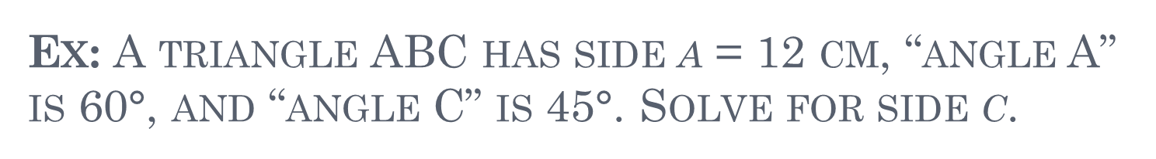
Ex: A triangle ABC has side a = 12 cm, “angle A” is 60°, and “angle C” is 45°. Solve for side c.
1st method: Build two right triangles
2nd method:
Use Sine Law
Plug all of this into your calculator

Slide 4
Practice: Find the value of “x”
Indicate the sides
and angles
Formula
Cross Multiply and
Solve for “X”
© Copyright all rights reserved to Homework depot: www.BCMath.ca

Slide 5
II) Finding Missing Angles
To find the angle, you need to use inverse sine
If the angle is obtuse, you need to find the angle in Quadrant #2
Ex: Find the value of “θ” to the nearest degree
Indicate the sides and angles
Formula
© Copyright all rights reserved to Homework depot: www.BCMath.ca

Slide 6
Example 2: A triangle has side a = 11 inches, angle A = 40°, and side c = 8 inches. Solve for angle C.
Use the Sine law to write out your equation, what you have and what you are looking for
Simplify the equation on the
left to get the ratio

Slide 7
Practice: Solve for the missing angles

Slide 8
Example 7: At noon, two tracking stations on Earth , station A is 20 km west of station B, measure a rocket that was launched from a weather satellite. From station A the angle of elevation is 41° and from station B the angle of elevation was 75°. Find the height of the rocket above the earth.
Notes:
8

Slide 9
Ex: The angle of elevation to the top of the tower is 43°. If you travels 100m closer, the angle is 75°. How tall is the tower? Assume the person is about 1.5m tall.
Make a Triangle and Gather Info
Find the Hypotenuse of the triangle
Use the Hypotenuse to find the opposite side
Height of
the Tower
© Copyright all rights reserved to Homework depot: www.BCMath.ca

Slide 10
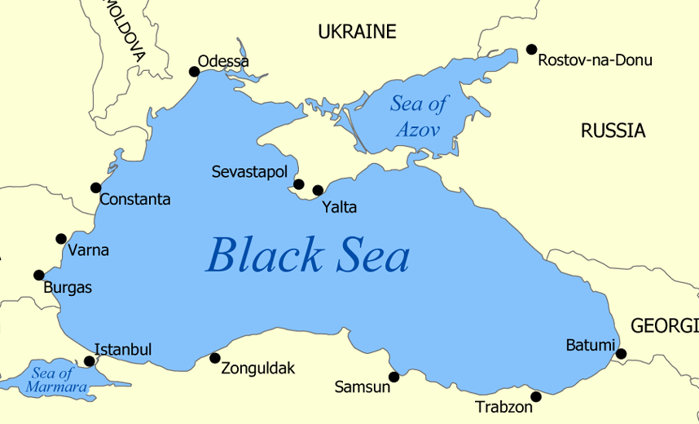
Practice: A ship leaves Batumi on a bearing 300 and sails 860km. They then change direction on a bearing of 222 and sail for 580km and reached Istanbul. How far is Batumi from Istanbul?
Turkey
© Copyright all rights reserved to Homework depot: www.BCMath.ca

Slide 11
Triangles with Obtuse Angles
An “obtuse” angle is an angle greater than 90
In an x-y plane, the angle will be in Quadrant 2
However, when looking at angle B the angle is obtuse (bigger than 90ᴼ)
So angle “B” can not be equal to 66.1683ᴼ, but should be in quadrant 2!

Slide 12
Practice: Find θ to the nearest degree
Formula
Formula
Angle “B” is an OBTUSE angle,
So it must be in Quadrant #2!!
Angle “B” is an OBTUSE angle,
So it must be in Quadrant #2!!
© Copyright all rights reserved to Homework depot: www.BCMath.ca

Slide 13
Proof For the Sine Law
If we use another altitude for
angle A, we can solve for the
other part of the sine law
© Copyright all rights reserved to Homework depot: www.BCMath.ca

